Slide 1
Java Expressions, Expression Evaluation, Priority and Associativity, Types of Operators and Examples
- SAYALI YADAV

Slide 2
JAVA EXPRESSIONS
In Java, an expression is a combination of values, variables, operators, and method invocations that are evaluated to produce a single value. An expression can be a single value or a combination of values that produce a result. Expressions can be used in various contexts, such as in assignments, conditional statements, and loops.
Types of Expressions in Java
Arithmetic expressions
Relational expressions:
Logical expressions:
Conditional expressions:
Assignment expressions:

Slide 3
Types of Expressions in Java
Arithmetic expressions: These expressions involve arithmetic operations such as addition, subtraction, multiplication, and division. For example, 2+3 is an arithmetic expression that evaluates to 5.
Relational expressions: These expressions involve comparing two values using relational operators such as "greater than," "less than," "equal to," and "not equal to." For example, 4<5 is a relational expression that evaluates to true.
Logical expressions: These expressions involve logical operations such as "AND," "OR," and "NOT." For example, (2<3)&&(3<4) is a logical expression that evaluates to true.
Conditional expressions: These expressions involve using the ternary operator "?:" to assign a value based on a condition. For example, int x = (5<6)?2:3; assigns the value 2 to x since 5 is less than 6.
Assignment expressions: These expressions involve assigning a value to a variable. For example, int x = 5; assigns the value 5 to the variable x.

Slide 4
Expression Evaluation
Evaluate an expression represented by a String. The expression can contain parentheses, you can assume parentheses are well-matched. For simplicity, you can assume only binary operations allowed are +, -, *, and /. Arithmetic Expressions can be written in one of three forms:
Infix Notation: Operators are written between the operands they operate on, e.g. 3 + 4.
Prefix Notation: Operators are written before the operands, e.g. + 3 4
Postfix Notation: Operators are written after operands. 34+

Slide 5
Infix Notation & Prefix Notation
1. Infix Notation
In infix notation, operators are placed between their operands. This is the most common way we write expressions in everyday arithmetic. However, it requires the use of parentheses to indicate the order of operations when needed.
Example:
Expression: 3+43 + 43+4
Complex Expression: (3+4)×5(3 + 4) \times 5(3+4)×5
2. Prefix Notation (Polish Notation)
In prefix notation, operators are placed before their operands. This notation eliminates the need for parentheses because the order of operations is unambiguous.
Example:
Expression: +34+ 3 4+34
Complex Expression: ×+345\times + 3 4 5×+345
This translates to (3+4)×5(3 + 4) \times 5(3+4)×5.

Slide 6
Postfix Notation
Postfix Notation (Reverse Polish Notation)
In postfix notation, operators are placed after their operands. Like prefix notation, postfix does not require parentheses.
Example:
Expression: 34+3 4 +34+
Complex Expression: 34+5×3 4 + 5 \times34+5×
This translates to (3+4)×5(3 + 4) \times 5(3+4)×5.
Evaluation:
The expression is evaluated from left to right. When an operator is encountered, it is applied to the most recent operands available.

Slide 7
PRIORITY AND ASSOCIATIVITY
Category | Operators | Associativity
Postfix | ++ - - | Left to right
Unary | + - ! ~ ++ - - | Right to left
Multiplicative | * / % | Left to right
Additive | + - | Left to right
Shift | << >> | Left to right
Relational | < <= > >= | Left to right

Slide 8
PRIORITY AND ASSOCIATIVITY
Category | Operators | Associativity
Equality | == != | Left to right
Bitwise AND | & | Left to right
Bitwise XOR | ^ | Left to right
Bitwise OR | | | Left to right
Logical AND | && | Left to right
Logical OR | || | Left to right
Conditional | ?: | Right to left
Assignment | = += -= *= /= %=>>= <<= &= ^= |= | Right to left
Equality | == != | Left to right

Slide 9
Operators In Java
Operators allow the execution of arithmetic calculations essential for any mathematical operations in your program.
They enable decision-making in the code through comparison and logical operators, directing the execution flow based on conditions.
They are used to manipulate data at both bit and byte levels, allowing for efficient data processing.
Operators like the assignment and unary operators simplify code by reducing complexity and increasing readability.
Operators, especially bitwise and shift operators, can perform operations faster than their functional equivalents, enhancing performance.

Slide 10
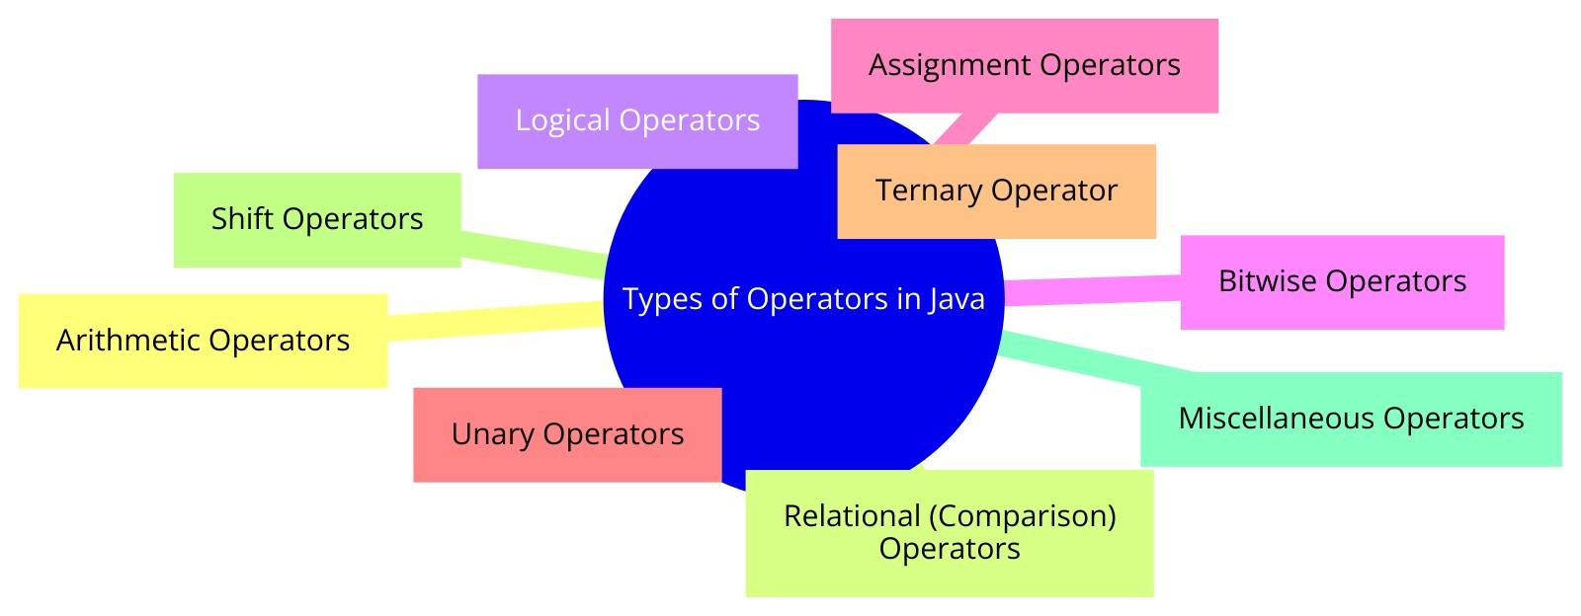
Types of Operators

Slide 11
ARTHMATAIC OPERATORS
Operator | Name | Description | Example
+ | Addition | Adds two values together. | 5 + 3 results in 8
- | Subtraction | Subtracts the second value from the first. | 5 - 3 results in 2
* | Multiplication | Multiplies two values. | 5 * 3 results in 15
/ | Division | Divides the first value by the second, giving the quotient. | 6 / 3 results in 2
% | Modulus | Computes the remainder of the division of the first value by the second. | 7 % 3 results in 1
++ | Increment | Increases the value by one. It can be used as a prefix or suffix. | If a = 5, then ++a or a++ results in 6
-- | Decrement | Decreases the value by one. It can be used as a prefix or suffix. | If a = 5, then --a or a-- results in 4

Slide 12
RELATIONAL OPERATORS
Operator | Name | Description | Example
== | Equal to | Checks if two values are equal. | 5 == 5 results in true
!= | Not equal to | Checks if two values are not equal. | 5 != 4 results in true
> | Greater than | Checks if the left value is greater than the right value. | 5 > 3 results in true
< | Less than | Checks if the left value is less than the right value. | 3 < 5 results in true
>= | Greater than or equal to | Checks if the left value is greater than or equal to the right value. | 5 >= 5 results in true
<= | Less than or equal to | Checks if the left value is less than or equal to the right value. | 3 <= 5 results in true

Slide 13
LOGICAL OPERATORS
Operator | Name | Description
&& | Logical AND | Returns true only if both operands are true.
|| | Logical OR | Returns true if at least one of the operands is true. If both operands are false, the result is false.
! | Logical NOT | Inverts the truth value of the operand.

Slide 14
BITWISE OPERATORS
Operator | Name | Description | Example
& | Bitwise AND | Compares each bit of two numbers. Bit is set if both bits are 1. | a & b
^ | Bitwise XOR | Compares each bit of two numbers. Bit is set if only one of the bits is 1. | a ^ b
~ | Bitwise NOT | Inverts all the bits of a number. | ~a

Slide 15
ASSIGNMENT OPERATORS
Operator | Name | Description | Example
= | Simple assignment | Assigns the right-hand operand's value to the left-hand operand. | a = b
+= | Add and assign | Adds both operands and assigns the result to the left operand. | a += b (equivalent to a = a + b)
-= | Subtract and assign | Subtracts the right operand from the left operand and assigns the result to the left operand. | a -= b (equivalent to a = a - b)
*= | Multiply and assign | Multiplies both operands and assigns the result to the left operand. | a *= b (equivalent to a = a * b)
/= | Divide and assign | Divides the left operand by the right operand and assigns the result to the left operand. | a /= b (equivalent to a = a / b)
%= | Modulus and assign | Takes modulus using two operands and assigns the result to the left operand. | a %= b (equivalent to a = a % b)

Slide 16
UNARY OPERATORS
Operator | Name | Description | Example
+ | Unary plus | Indicates the positive value of a variable. | +a
- | Unary minus | Negates the value of a variable. | -a
++ | Increment | Increases an integer's value by one. | a++ or ++a
-- | Decrement | Decreases an integer's value by one. | a-- or --a
! | Logical NOT | Inverts the boolean value of a condition. | !true is false

Slide 17
TERNARY OPERATOR
The ternary operator in Java is the only conditional operator that takes three operands and is a shorthand for the if-else statement.
Syntax:
condition ? expression1 : expression2;
Here's what each part of the ternary operator means:
condition: This is a boolean expression that evaluates to either true or false.
expression1: This expression is executed if the condition is true.
expression2: This expression is executed if the condition is false.
grade = (score >= 90) ? "A" :
(score >= 80) ? "B" : "C";

Slide 18
SHIFT OPERATORS
Operator | Name | Description | Example
<< | Shift left | Shifts the bits of the number to the left and fills 0 on voids left as a result. The leftmost bits are discarded. | a << 2
>> | Shift right | Shifts the bits of the number to the right. Sign bits are used to fill the voids left from the shift. | a >> 2
>>> | Unsigned shift right | Shifts the bits of the number to the right and fills 0 on voids left. | a >>> 2

Slide 19
MISCELLANEOUS OPERATORS
Operator | Name | Description | Example
instanceof | Type check | Checks whether an object is an instance of a specific class or implements an interface. | obj instanceof String
(type) | Cast | Converts a variable to a specified type. | (int) 5.99

